Slide 1
Comment Moderation: Identifying Toxic Comments
Kin-Yip

Slide 2
Comment Moderation
Problems:
Scale: 11,000 comments are posted to the New York Times website each day.
Consistency: Human moderators can be fickle.
Different websites may want different standards of moderation with regards to swearing and tone.
Solutions:
Computers are fast, consistent, and can handle different policies.
160,000 comments scored in minutes.

Slide 3
English Wikipedia Comments Corpus
160,000 comments labeled by up to 10 human annotators each through Crowdflower.
Multiple labels:
Toxic (perceived as likely to make people want to leave the discussion)
Subtypes: (Severe toxic, obscene, threat, insult, identity hate)
Goal:
Build the best model in the world.

Slide 4
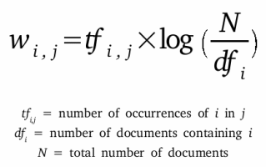
Term Frequency-Inverse Document Frequency

Slide 5
Soft Voting Classifier
Ensemble of:
Multinomial Naive Bayes
Elastic net Logistic Regression
Scikit-learn Random Forest
LightGBM
Averages predicted probabilities from each base learner.
Theoretically, an ensemble formed from uncorrelated models will reduce bias and variance.

Slide 6
Model Selection
model | fit_time | fit_std | score_time | score_std | AUC | AUC_std
Multinomial NB | 2.521 | 0.172 | 0.509 | 0.090 | 0.951 | 0.002
Elastic Net Logit | 2.842 | 0.286 | 0.475 | 0.062 | 0.968 | 0.002
sklearn RF | 112.597 | 0.401 | 1.271 | 0.038 | 0.929 | 0.003
LightGBM Classifier | 129.962 | 0.806 | 0.894 | 0.141 | 0.967 | 0.002
Soft Voting Ensemble | 242.908 | 7.552 | 9.956 | 5.467 | 0.972 | 0.001

Slide 7
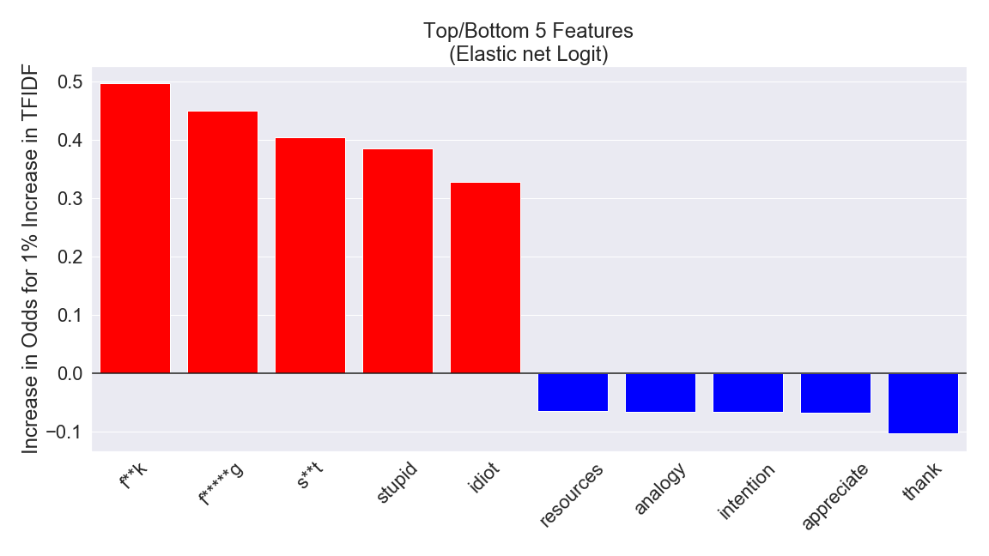

Slide 8
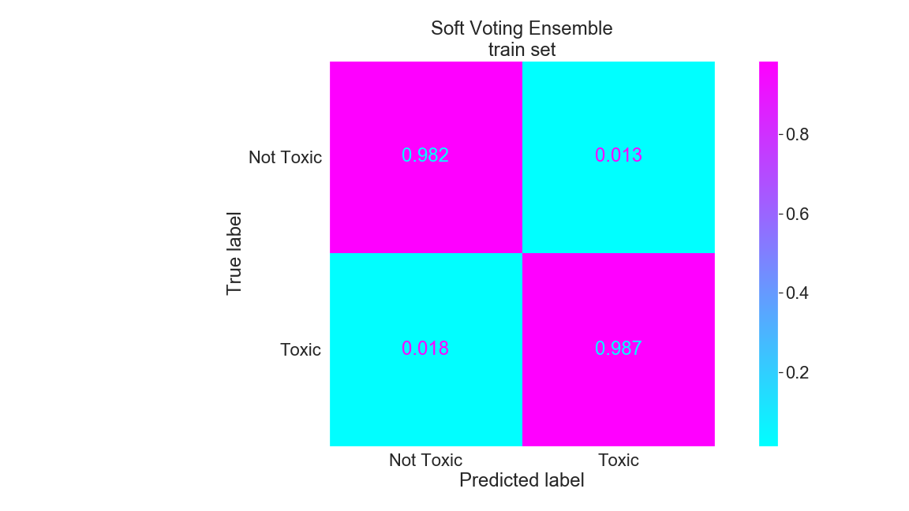

Slide 9
Toxic Comments Classified as Not Toxic
Models cannot understand tone:
“... In my humble opinion this draft is a pathetically watered-down rendition of what's been discussed and usually agreed upon by everyone except you-know-who. Denazification reduced to half a sentence?...”
Comments referencing other non-toxic comments:
I have to put this as sittign here cackling my head off. Are you peopel on leave from a psyche hospital? I just found the following post from prissy Dame Ewart on some other user's talk page…
“Ms Gundagai, normally I would be thrilled to be the centre of so much attention (so far all your edits, except those to your userpage, have been devoted to me)...”

Slide 10
Not Toxic Comments Classified as Toxic
Models only check for offensive words and cannot understand context:
“But keep in mind I am a gay Jew.”
Human raters are flawed:
“hey dude i d like to know who is in charge of all of this deleting that is going on, i did a thing on the harly drags, and some punk ass f****t deleted it and i really dont appreciate that very much at all, and im kinda very extremely pissed and i think that since it wasnt good enough for yall nerds then yall should write abput it , but yall dont have any clue what it is cuz you aint been you no p***y gettin guy.... feel free to write me back dude”

Slide 11
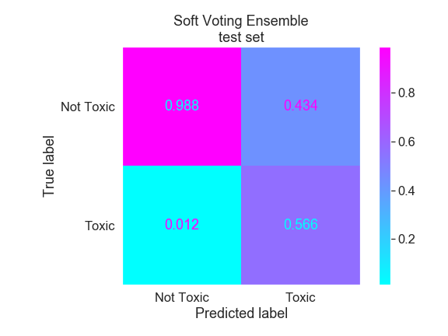
Soft Voting Ensemble
AUC: 0.972

Slide 12
Future Directions
Extract more features: parts-of-speech
Hyperparameter tuning:
other methods to handle imbalanced classes, character n-grams, word n-grams, model hyperparameters, prediction thresholding, stacking ensembles, etc.
Predict subclasses
Address unintended bias

Slide 13
QUESTIONS?

